Slide 1

UNIVERSITY COLLEGE OF ENGINEERING,PANRUTI (A CONSTITUENT COLLEGE OF ANNA UNIVERSITY, CHENNAI) PANRUTI - 607 106. DEPARTMENT OF COMPUTER SCIENCE AND ENGINEERING
FINAL YEAR PROJECT - FIRST REVIEW
Batch no :10 Date :29-03-2023
PREDICTIVE AGRICULTURE:IMPROVING CROP YIELDS WITH
DATA - DRIVEN INSIGHTS
PRESENTED BY
ABINASH M (422619104001)
AKALYA A (422619104003)
BHAVESHRAJ A (422619104006)
GUIDED BY
MRS.A.SIVARANJANI., M.TECH.,

Slide 2
ABSTRACT
Machine learning in agriculture enables farmers to make data-driven decisions that can help them increase their profits even as lowering their environmental impact.
This model can forecast crop defects and help them to enhance their forecasting abilities.
This model will be trained on a dataset of past and present crop data, utilizing a variety of computer vision techniques and algorithms to define patterns and make reliable estimate.
This process aims to support farmers in making informed planting and harvesting decisions, improve overall its productivity and efficiency of their agriculture production.

Slide 3
PROPOSED WORK
The proposed work aims to develop a novel ML-based solution that can provide farmers with valuable insights into crop patches, helping to improve productivity and profitability in agriculture.
The proposed solution will helpful for the farmers to improve and develop their cultivation techniques profitably.
The objective is to develop an automated crop patch detection system that can accurately identify and map crop patches to give better suggestions to farmers.

Slide 4
ARCHITECTURE DIAGRAM
Data cleaning
(handle outliers and dup)
Model training
Model selection(selecting algorithms
)
Data splitting
Model evaluation
Hyperparameter tuning
DATA COLLECTION
(CSV,JSON,etc)
Data Exploration
(EDA) visualize data
Training
Testing
MODEL TESTING
FIGURE 1.1:ARCHITECTURE DIAGRAM

Slide 5
MODULE SPLIT UP
MODULE 1
MODULE 2
MODULE 3
MODULE 4
MODULE 5
DATA COLLECTION
DATA PREPROCESSING
FEATURE ENGINEERING
MODEL TRAINING
MODEL EVALUATION

Slide 6
MODULE DESCRIPTION
DATA COLLECTION MODULE:
This module is responsible for collecting data from various sources,such as databases ,APIs and it may involve data extraction,transformation,and loading operations.
DATA PREPROCESSING MODULES:
This module is responsible for both the DATA CLEANING and DATA EXPLORATION modules . DATA CLEANING is used for cleaning the data,which includes removing missing data and handling outliers. where DATA EXPLORATION is used to explore the clean data through (EDA)

Slide 7
4. FEATURE ENGINEERING MODULE:
This module is used for creating new features or transforming the existing features to improve the model performance.
5. MODEL TRAINING MODULE:
This module is used to train the chosen algorithm on the training data.it involves optimizing the algorithm’s parameters to minimize the error between the predicted and actual values.
6. MODEL EVALUATION MODULE:
This module is used for testing the final model on testing set to get an estimate of its performance on unseen data.

Slide 8
ALGORITHMS WITH COMPLEXITY
Support Vector Machines (SVM): This algorithm is used for classification and regression tasks. It separates the input data into different classes by creating a hyperplane that maximizes the margin between the classes.
K-Nearest Neighbors (KNN): This algorithm is used for classification and regression tasks. It makes predictions based on the similarity between the input data point and the k-nearest neighbors in the training data.
Naive Bayes: This algorithm is used for classification tasks. It calculates the probability of each class based on the input features using Bayes' theorem and makes predictions based on the highest probability.

Slide 9
Support Vector Machines (SVM):
Time complexity: O(n^3) for the standard algorithm, or O(n^2) for the sequential minimal optimization (SMO) algorithm.
Space complexity: O(n^2) for storing the kernel matrix.
K-Nearest Neighbors (KNN):
Time complexity: O(nd log n) for building the search tree, and O(kd) for finding the k nearest neighbors.
Space complexity: O(nd) for storing the data and search tree.
Naive Bayes:
Time complexity: O(nd) for counting the occurrences of features and classes.
Space complexity: O(nd) for storing the counts.

Slide 10
EXPECTED OUTCOMES
IMPROVED ACCURACY: improvised accuracy in predicting or classifying new data
IMPROVED INSIGHTS:reveal insights and patterns in data that may not be immediately apparent to human analysis.
IMPROVED DECISION MAKING: It can provide decision support to humans,helping them more informed decisions based on the data and predictions.

Slide 11
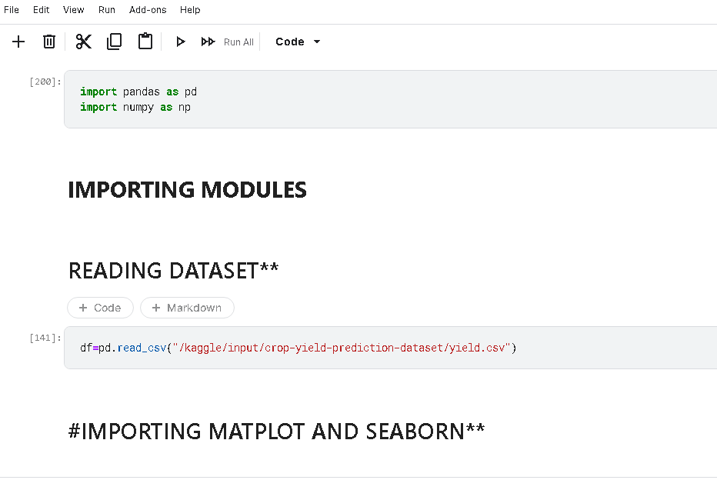
1st Module implementation

Slide 12
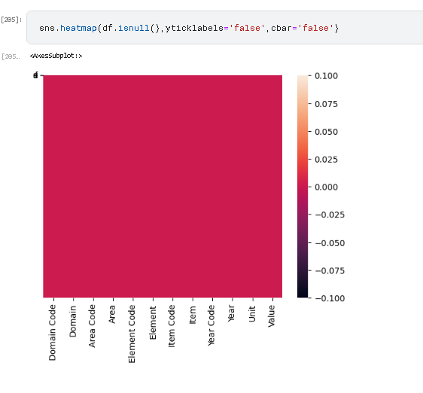

Slide 13
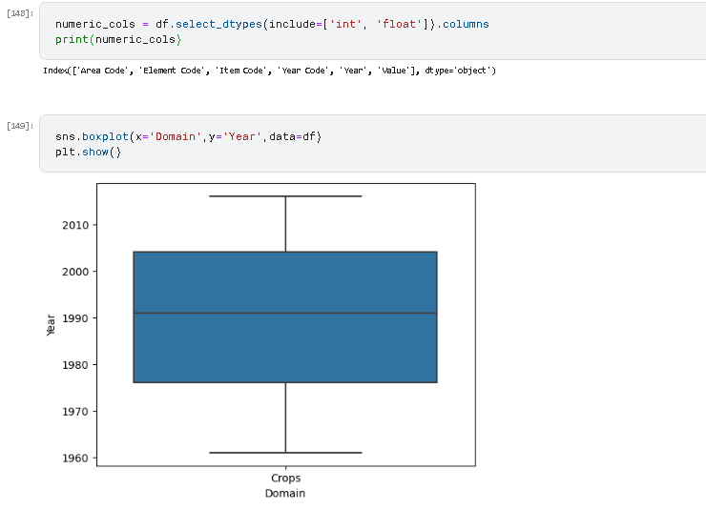

Slide 14
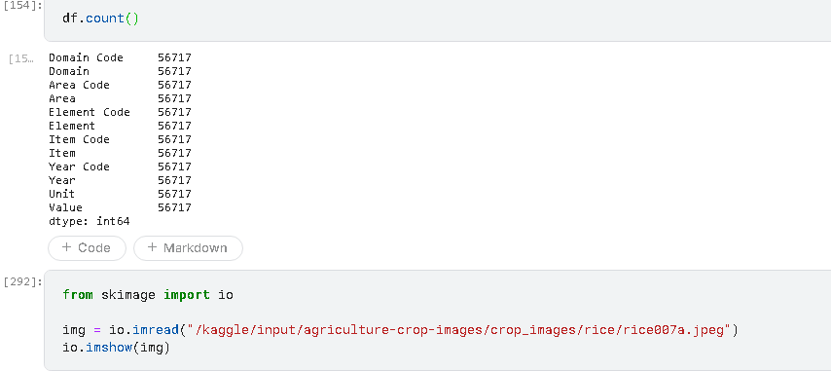

Slide 15
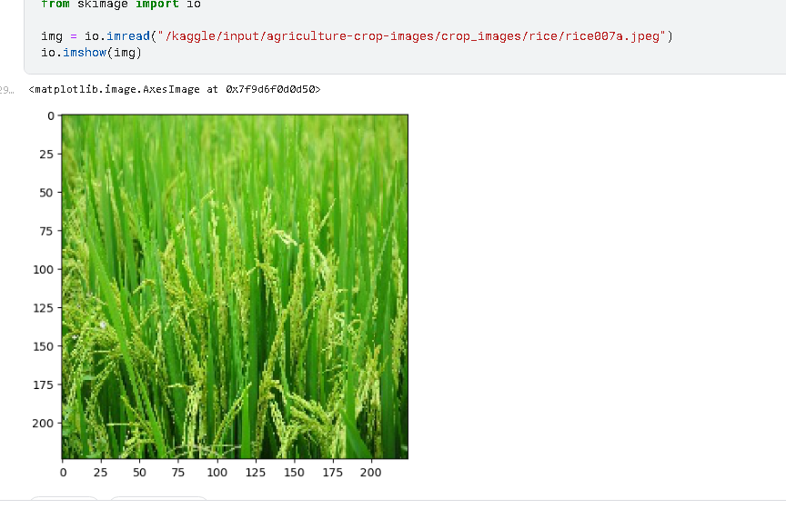

Slide 16
REFERENCES
Improvised extreme learning machine for crop yield prediction by Swati vashisht, Praveen kumar, Munesh chandra.(2021)
Prediction of crop yield based on soil moisture using machine learning algorithms by Sindhu madhuri G, Sameer paudel, Prasanth giri, Shanthanu bagathur karki (2020)
Crop yield prediction using machine learning algorithm by Iswariya, Nagapooja, Ragavi.(2022 )
A patch-image based classification approach for detection of weeds in sugar beet crop S.Imran moazzam, Umar s.khan, Waqar s, javid iqbal, and Amir hamza.(2021)

Slide 17
REFERENCES
Intelicrop: an ensemble model to predict crop using machine learning algorithms Meera gandhi Sasmitha s, Choudhury(2022)
Crop and weed classification in aerial imagery sesame crop field using patch based deep learning models, Umars.khan, Waqars.qureshi, Wahir namas.(2022)

Slide 18
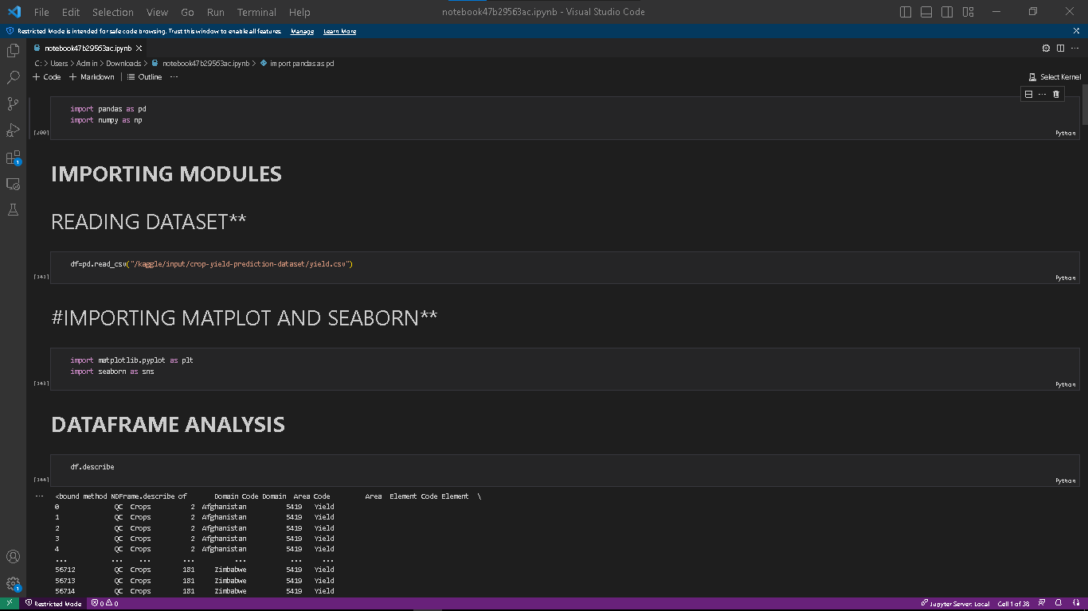
30% of coding implementation

Slide 19
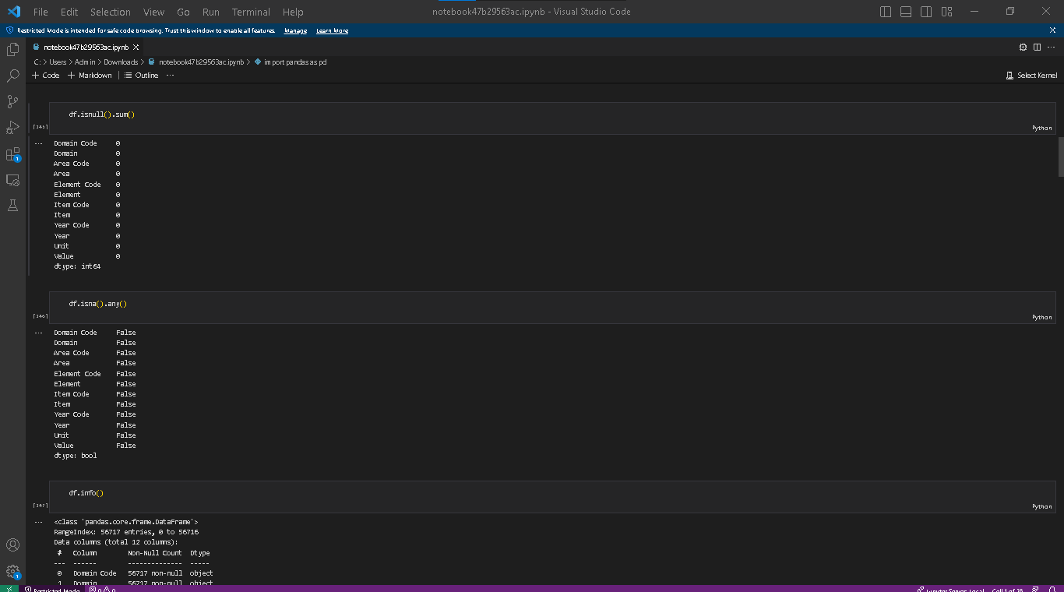

Slide 20
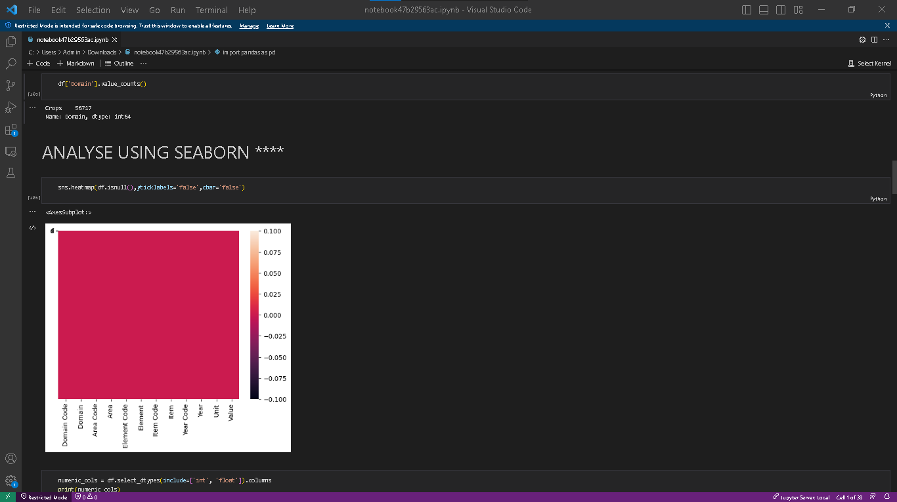

Slide 21
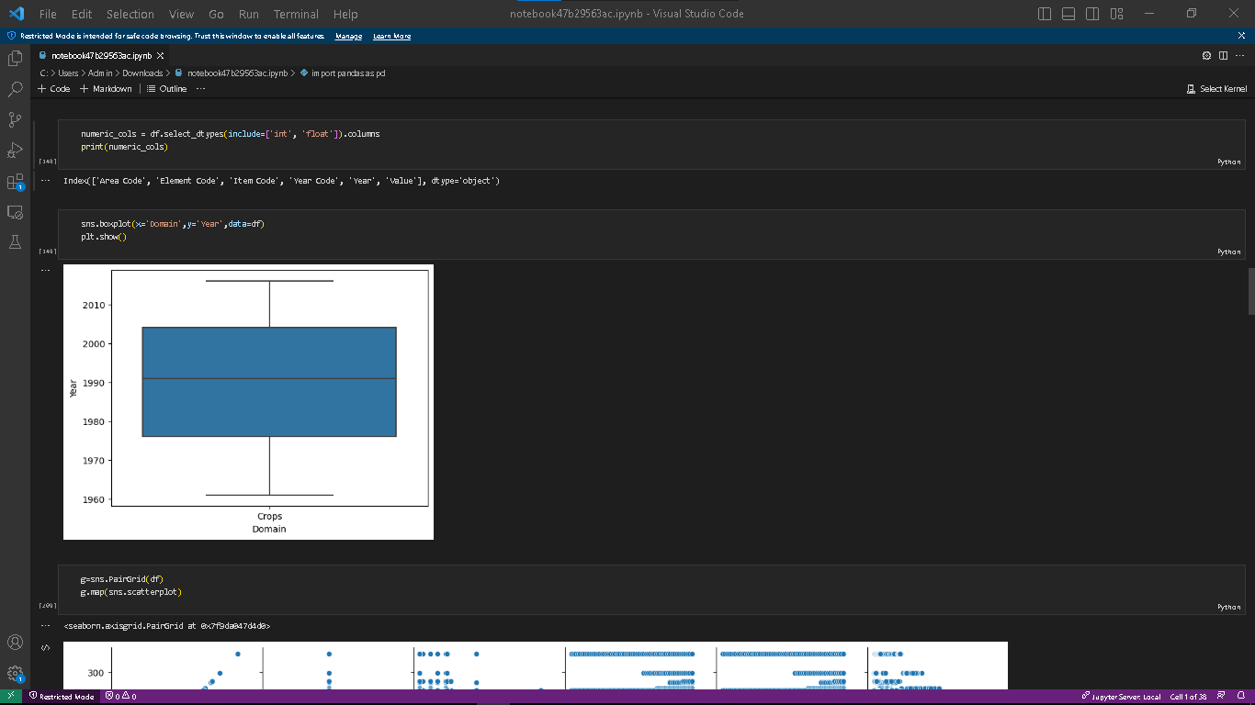

Slide 22
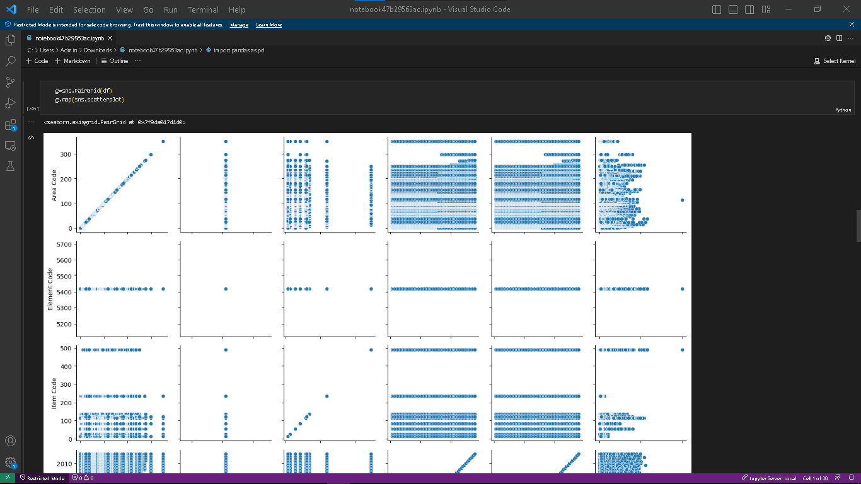

Slide 23
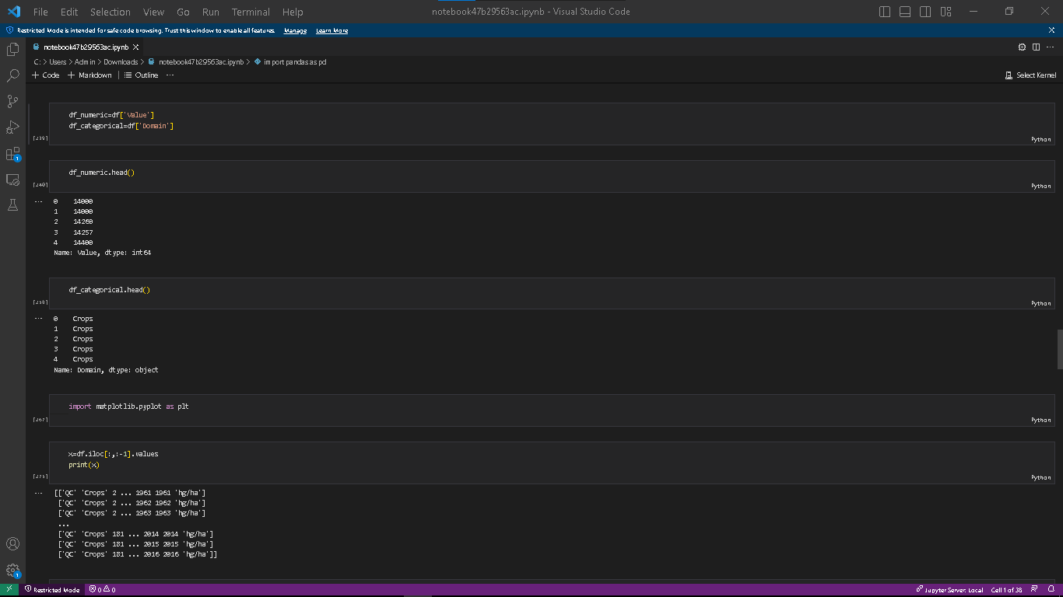

Slide 24
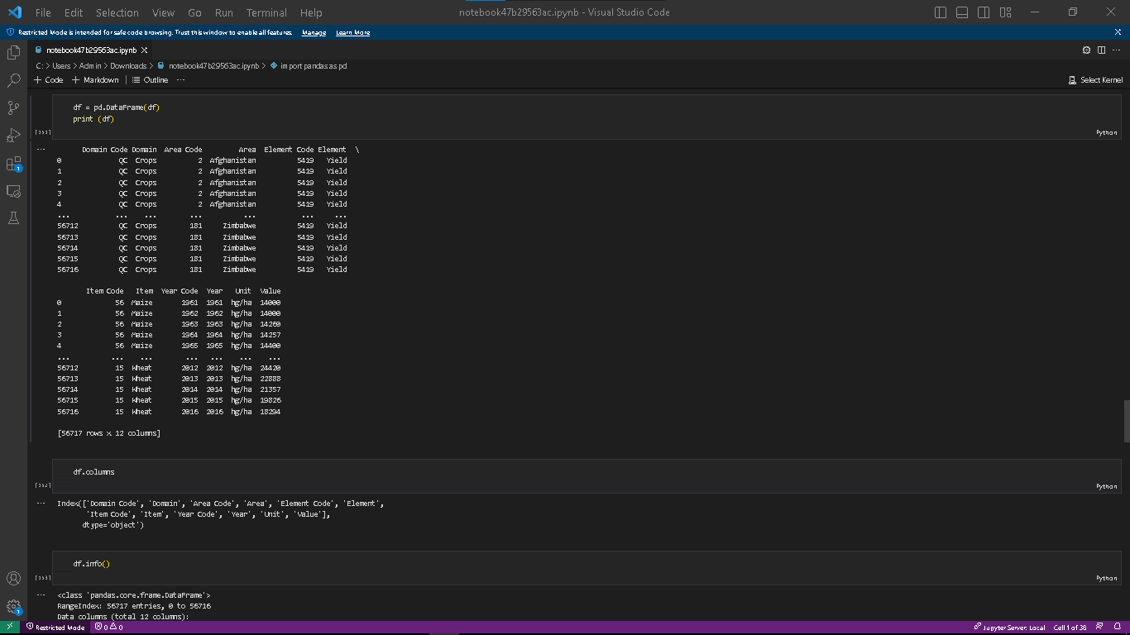

Slide 25
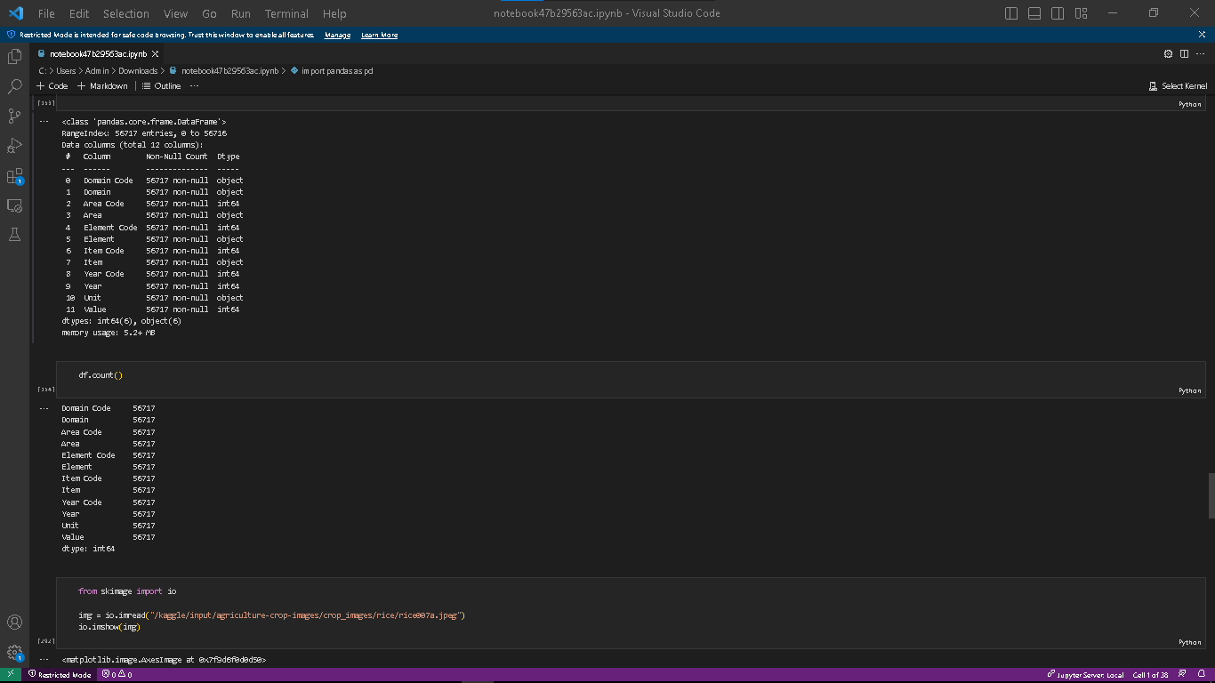

Slide 26
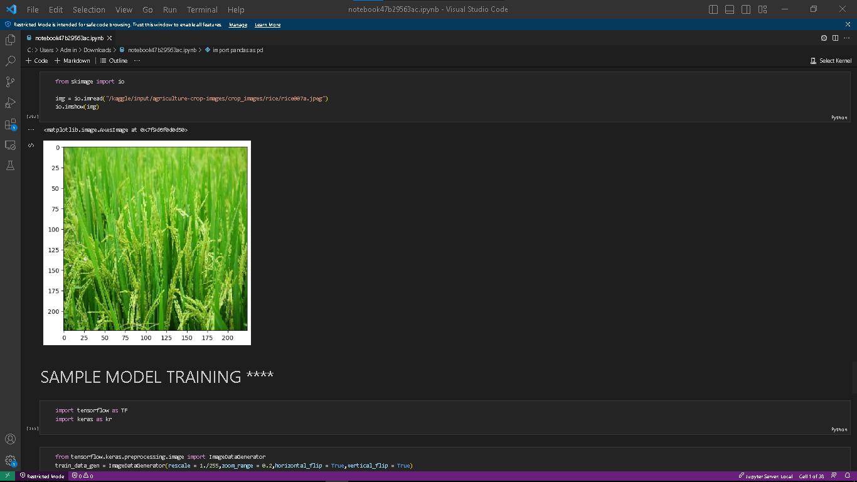

Slide 27
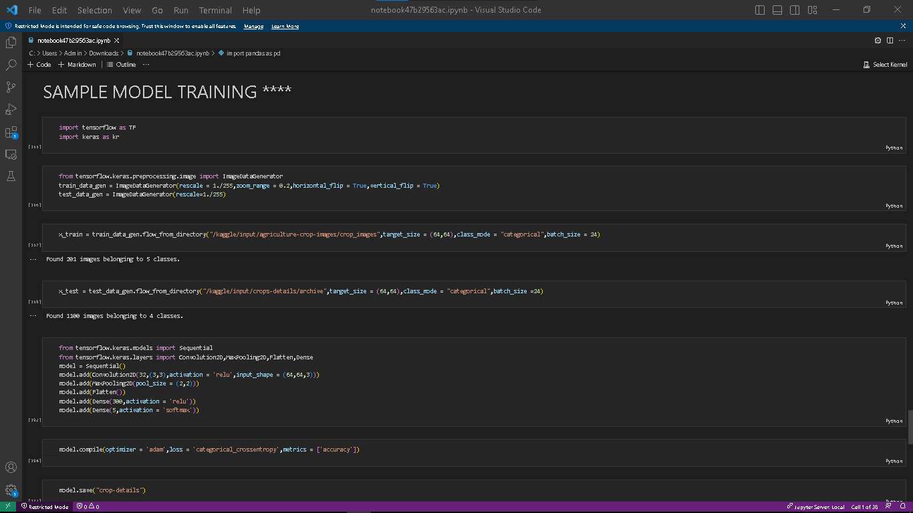

Slide 28
